Slide 1


Is Luck A Skill?
Bryer Cashman

Slide 2

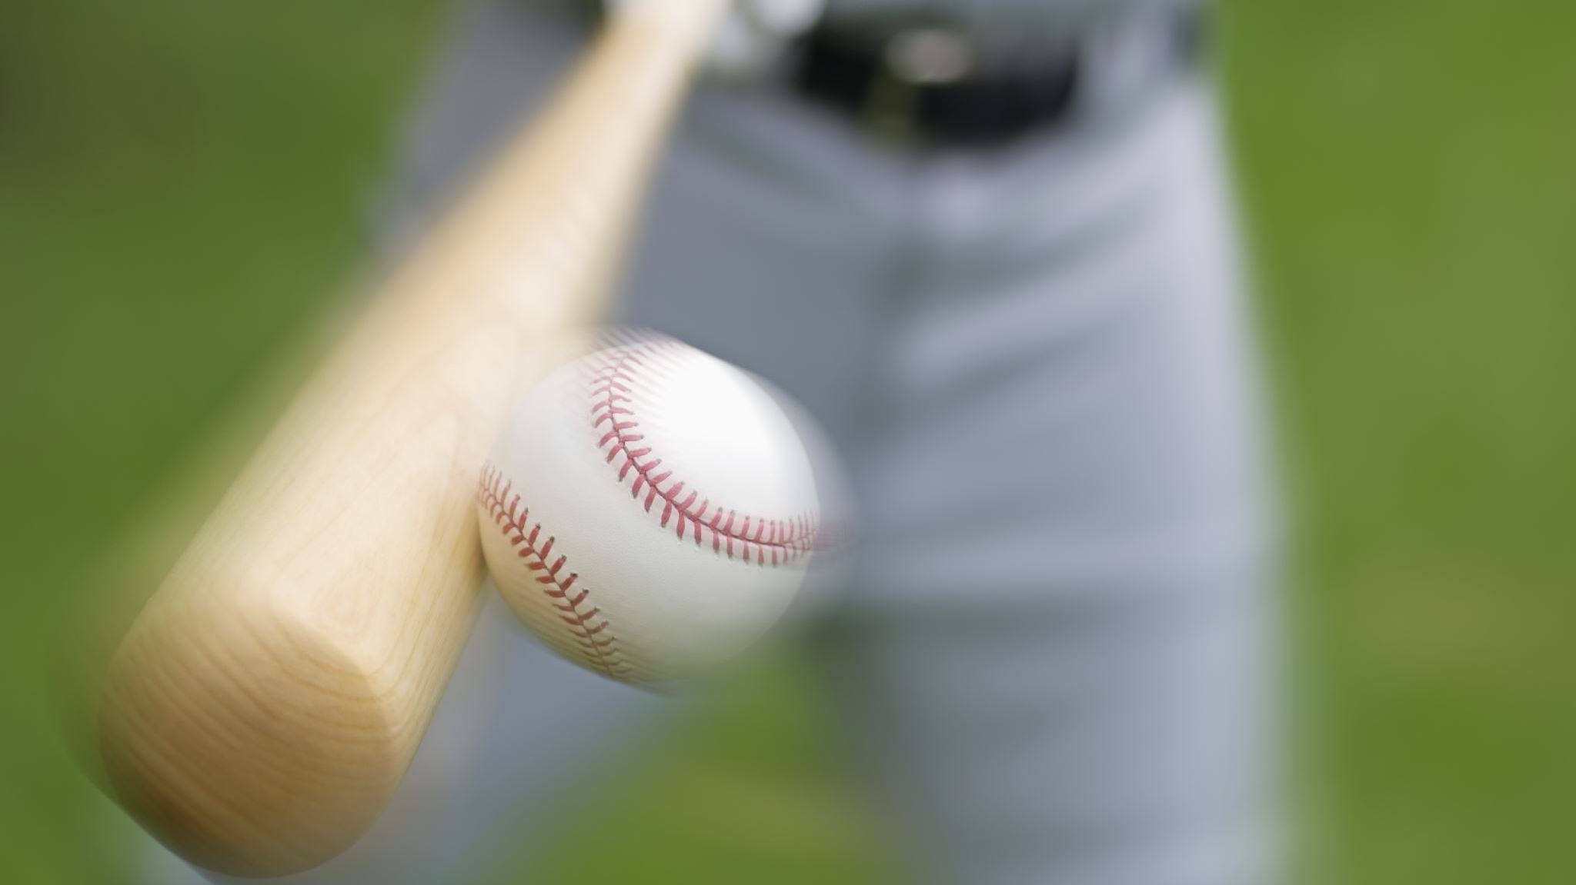
My Premise
Do certain hitters get consistently “lucky” or ”unlucky”?

Slide 3
Defining Luck
I will be using Woba and Xwoba to define luck
Woba-Xwoba
A positive difference meaning the hitter was “lucky”
A negative difference meaning the hitter was “unlucky”
These two numbers usually correlate very strongly, especially over large samples
The mean difference in 2021 and 2022 was almost exactly 0

Slide 4


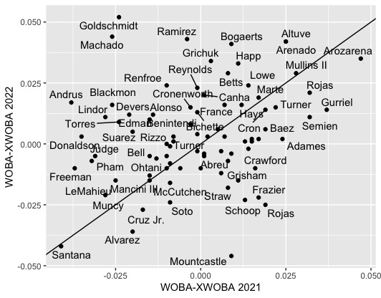
Correlation: .247

Slide 5
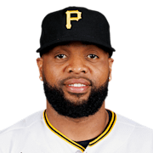
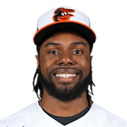
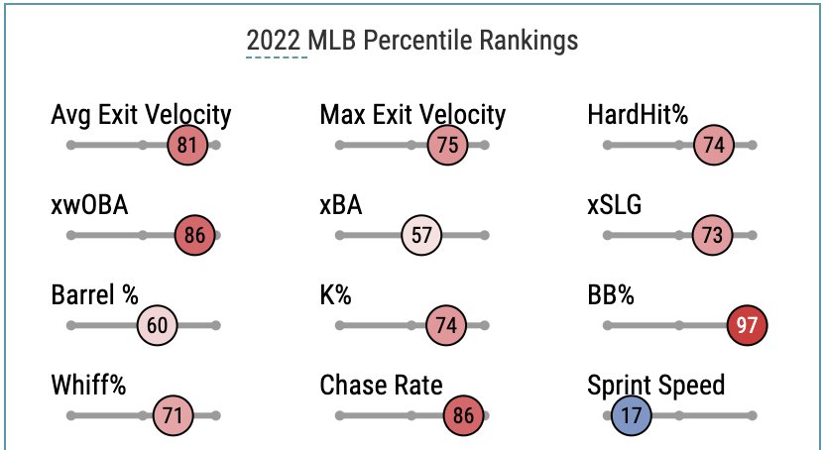
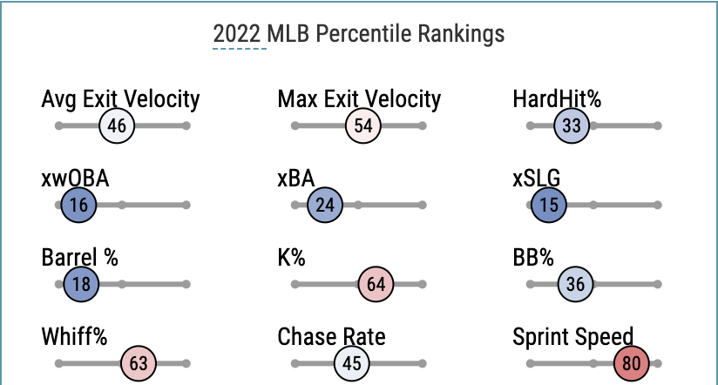
Examples
Carlos Santana
2021 Woba: .294
2021 Xwoba: .335
2022 Woba: .308
2022 Xwoba: .350
Cedric Mullins
2021 Woba: .372
2021 Xwoba: .344
2022 Woba: .315
2022 Xwoba: .286

Slide 6
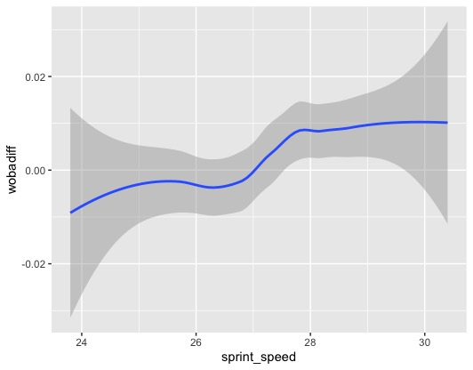
Sprint Speed’s Effects

Slide 7
Other Factors to Consider
Batted Ball Spray Angle
Shift
Corey Seager: Underperformed Xwoba from 2020-2022
Park
Ryan Mountcastle: Severely “unlucky” since change at Camden Yards

Slide 8

What’s Next
Expanding upon this
Look at more factors
RHH vs LHH
Pitches faced
Swing path
Is there anything to take advantage of?
Looking at Pitchers in the same way

